Slide 1
R Bootcamp: Loading Data
August 23-24, 2021

Slide 2
Learning Objectives
Load different files into R using {base} and {readr} packages
Flat files (csv and txt)
Excel file (xlsx)
Stata data format (dta)
Google Sheet
API
Specify which sheet of an Excel spreadsheet to load
Tell R to skip empty rows when loading data

Slide 3
Flat files
csv files – read.csv() from {base} or read_csv() from {readr}
carbon <- read_csv(here("data", "yearly_co2_emissions.csv"))
carbon <- read.csv(here("data", "yearly_co2_emissions.csv"), sep = ",", header = TRUE)
sep = “,” means that the data is comma delimited
header = TRUE indicates that the first row is variable names
Additional info: https://medium.com/r-tutorials/r-functions-daily-read-csv-3c418c25cba4#:~:text=The%20read_csv%20function%20imports%20data,load%20faster

Slide 4
Flat files
txt files
provinces <- read.table(here("data", "province.txt"), sep = "\t", header = TRUE)
sep = “\t” means that the data is tab delimited
header = TRUE indicates that the first row is variable names

Slide 5
Excel files
xlsx files
gdp <- read_xlsx(here("data", "gdp_pc.xlsx"))
If data is stored in separate sheets,
energy_hist <- read_xlsx(here("data", "energy_use_per_person.xlsx"), sheet = 1)
energy_recent <- read_xlsx(here("data", "energy_use_per_person.xlsx"), sheet = 2)
Part of {readr} package

Slide 6
Merge
Let’s merge or join the two energy files we just loaded into R.
energy <- full_join(energy_hist, energy_recent, by = c("country"))
energy_basemerge <- merge(energy_hist, energy_recent, by = c("country"), all.x = TRUE, all.y = TRUE)

Slide 7
Stata files
Stata files
politics <- read.dta13(here("data", "politics.dta"), nonint.factors = TRUE)
The argument `nonint.factors = TRUE` is to keep factor labels instead of the value itself. You can try loading the data with and without that argument to see the difference.

Slide 8
Google Sheets
gs4_deauth() # so no need to sign in
disasters <- read_sheet("https://docs.google.com/spreadsheets/d/17s15o7jdDpGSKgsIboZdnYU2UxHtU9DHKNRmYVVgwJo/edit#gid=0", skip = 2)
The argument “skip = 2” tells R to start reading the data from the third row.

Slide 9
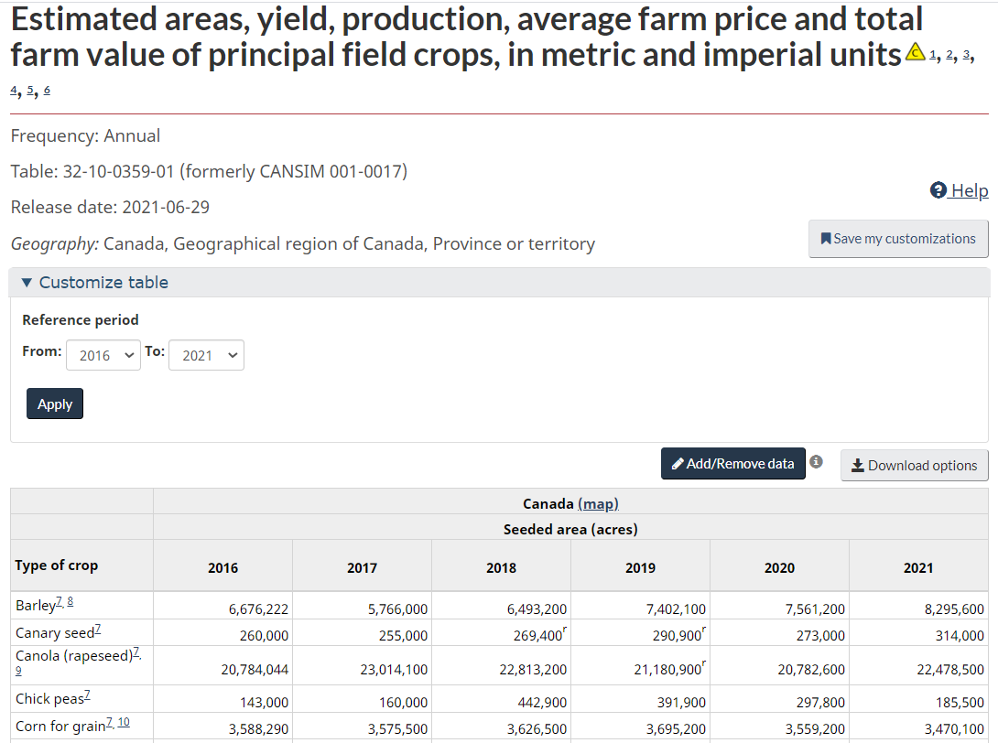
API
Let’s say you want to work with this table from Statistics Canada.

Slide 10
API
You can download the Excel file, save it in your computer, and load it using one of the functions discussed earlier.
Or you can use the {cansim} package which connects straight to the Statistics Canada database.
ag <- get_cansim('32-10-0359-01')

Slide 11
What we just did
Load data in different ways
Flat files (csv and txt)
Excel file (xlsx)
Stata data format (dta)
Google Sheet
API

Slide 12
Viewing your data
You can view your data with the command View(dataframe_name) or by clicking the data object in your Environment tab
The ability to click and look at your data is an advantage of using an Rstudio over R.

Slide 13
Inspecting your data
Here are a few functions to inspect your data
Size
dim(politics)
nrow(politics)
ncol(politics)
Content
head(politics) or tail(politics)
politics %>% slice_head(n = 7)
politics %>% slice_sample(n = 10)

Slide 14
Inspecting your data
Column Names
names(politics)
Summary
str(politics)
summary(politics)
glimpse(politics)

Slide 15
Subsetting Data Frames
Recall that we use [ ], [[ ]], or $ to extract certain columns and rows from our data frame.
politics[1, 2]
politics[c(5:10), ] #extract rows 5-10 and all columns
politics[c(5:10), c(1:3)] #extract rows 5-10 and columns 1-3
politics$country #extract the country column **
table(politics$country)

Slide 16
Q & A
How would you describe the carbon and gdp data frames?
How are they similar/different from the politics data frame?

Slide 17
Research Question
From this point on, we will just look at the carbon, gdp, and politics data frames.
We want to explore the following research questions:
Do richer countries emit more carbon emissions?
If we have time: How does a country’s level of democracy affect emissions?

Slide 18
Tidy Data
Now that we have our data in R and know what it looks like, we want to make sure that the data is in tidy format before we proceed with any analysis.

Slide 19
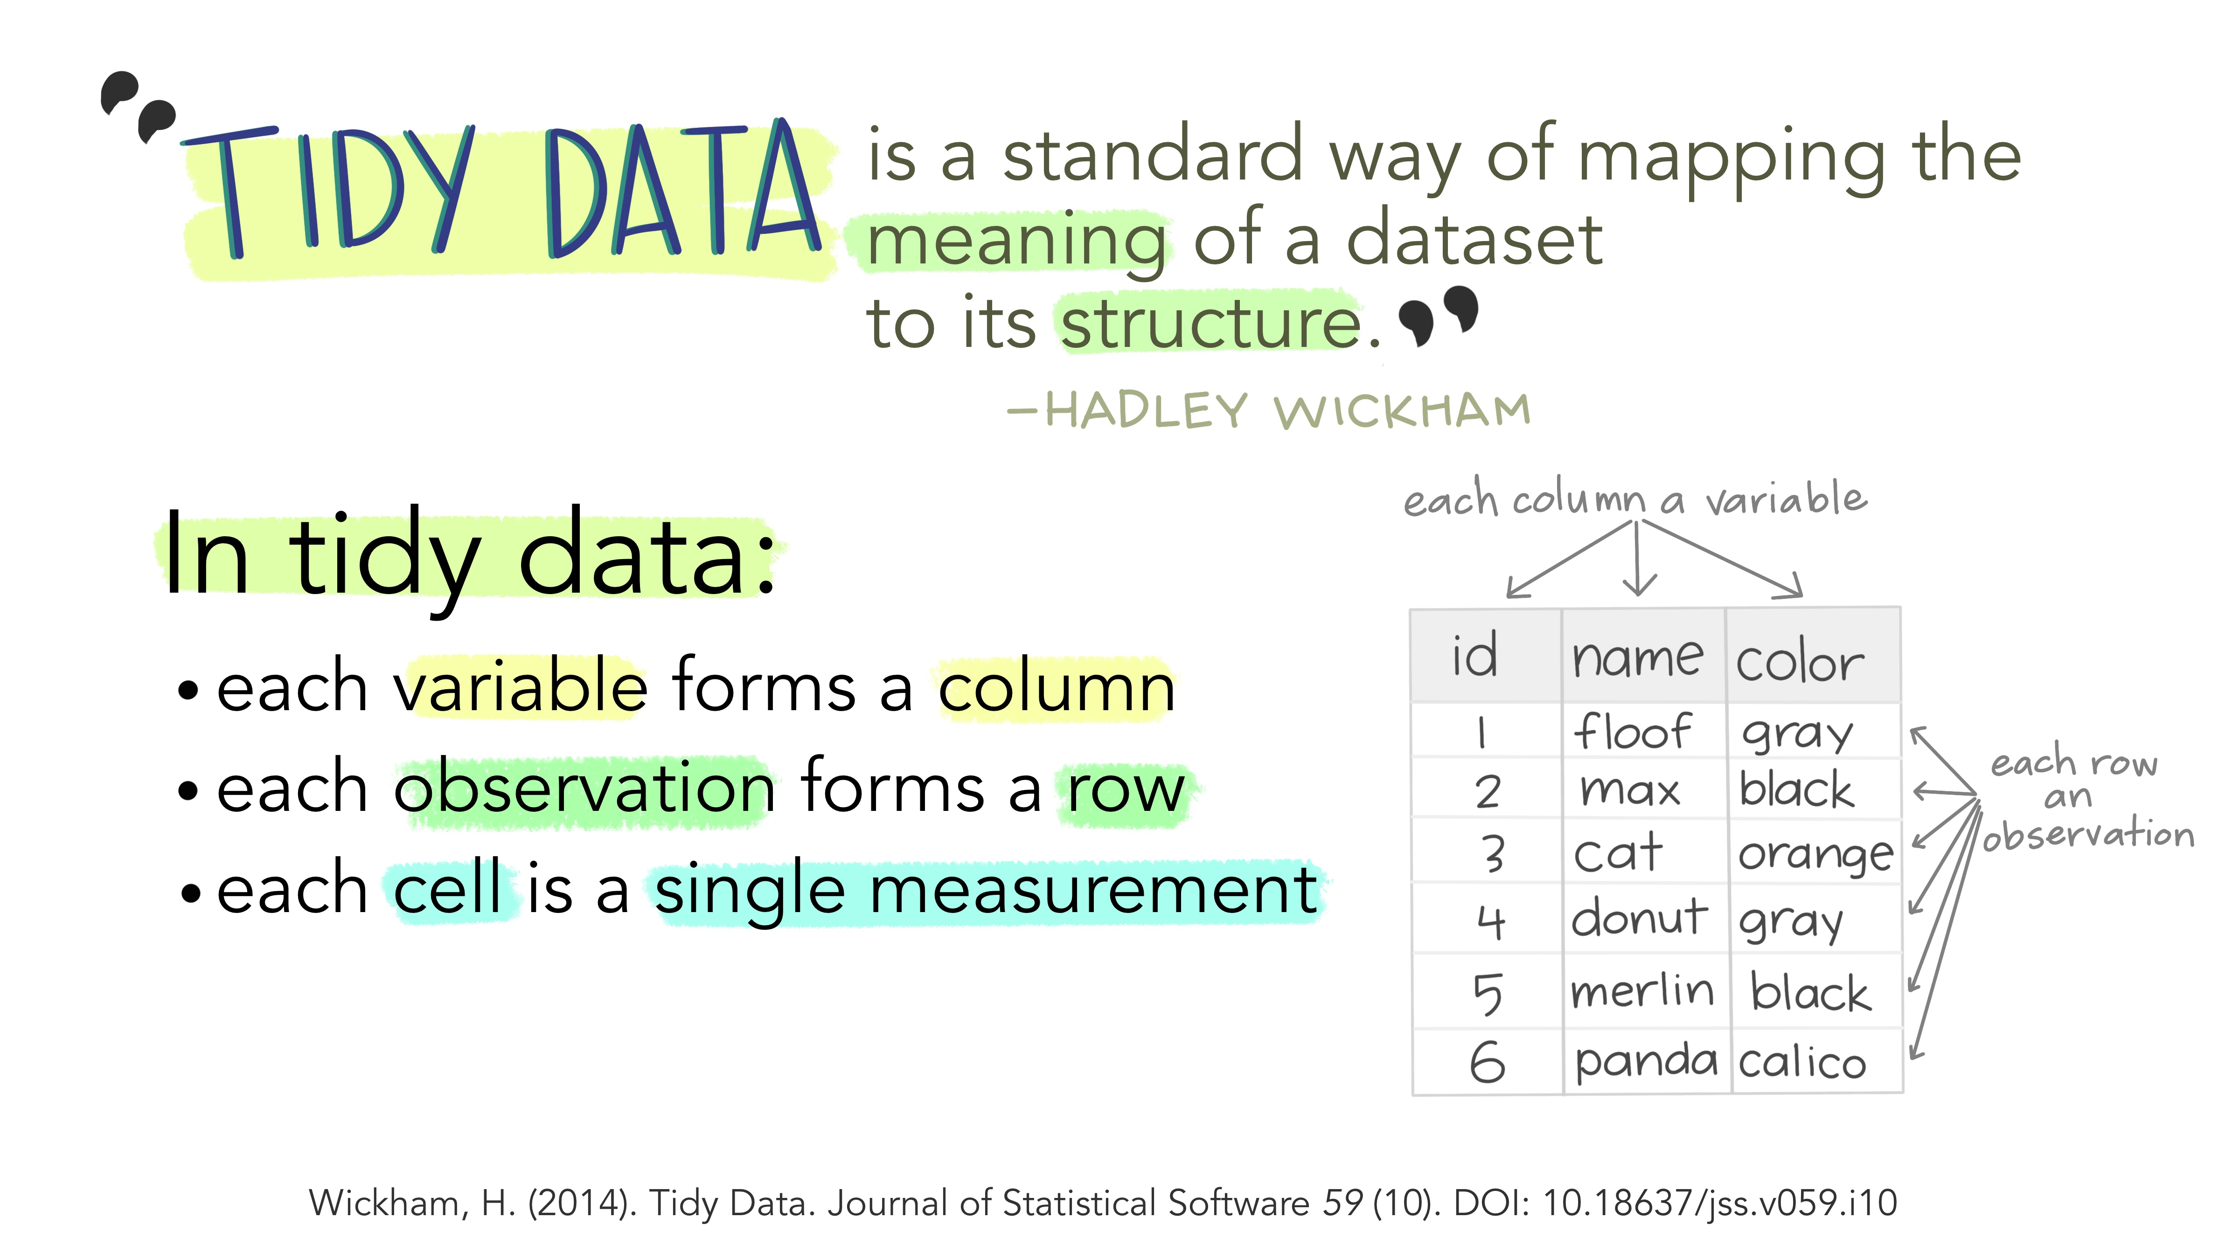
Tidy data
"Illustrations from the Openscapes blog Tidy Data for reproducibility, efficiency, and collaboration by Julia Lowndes and Allison Horst"

Slide 20
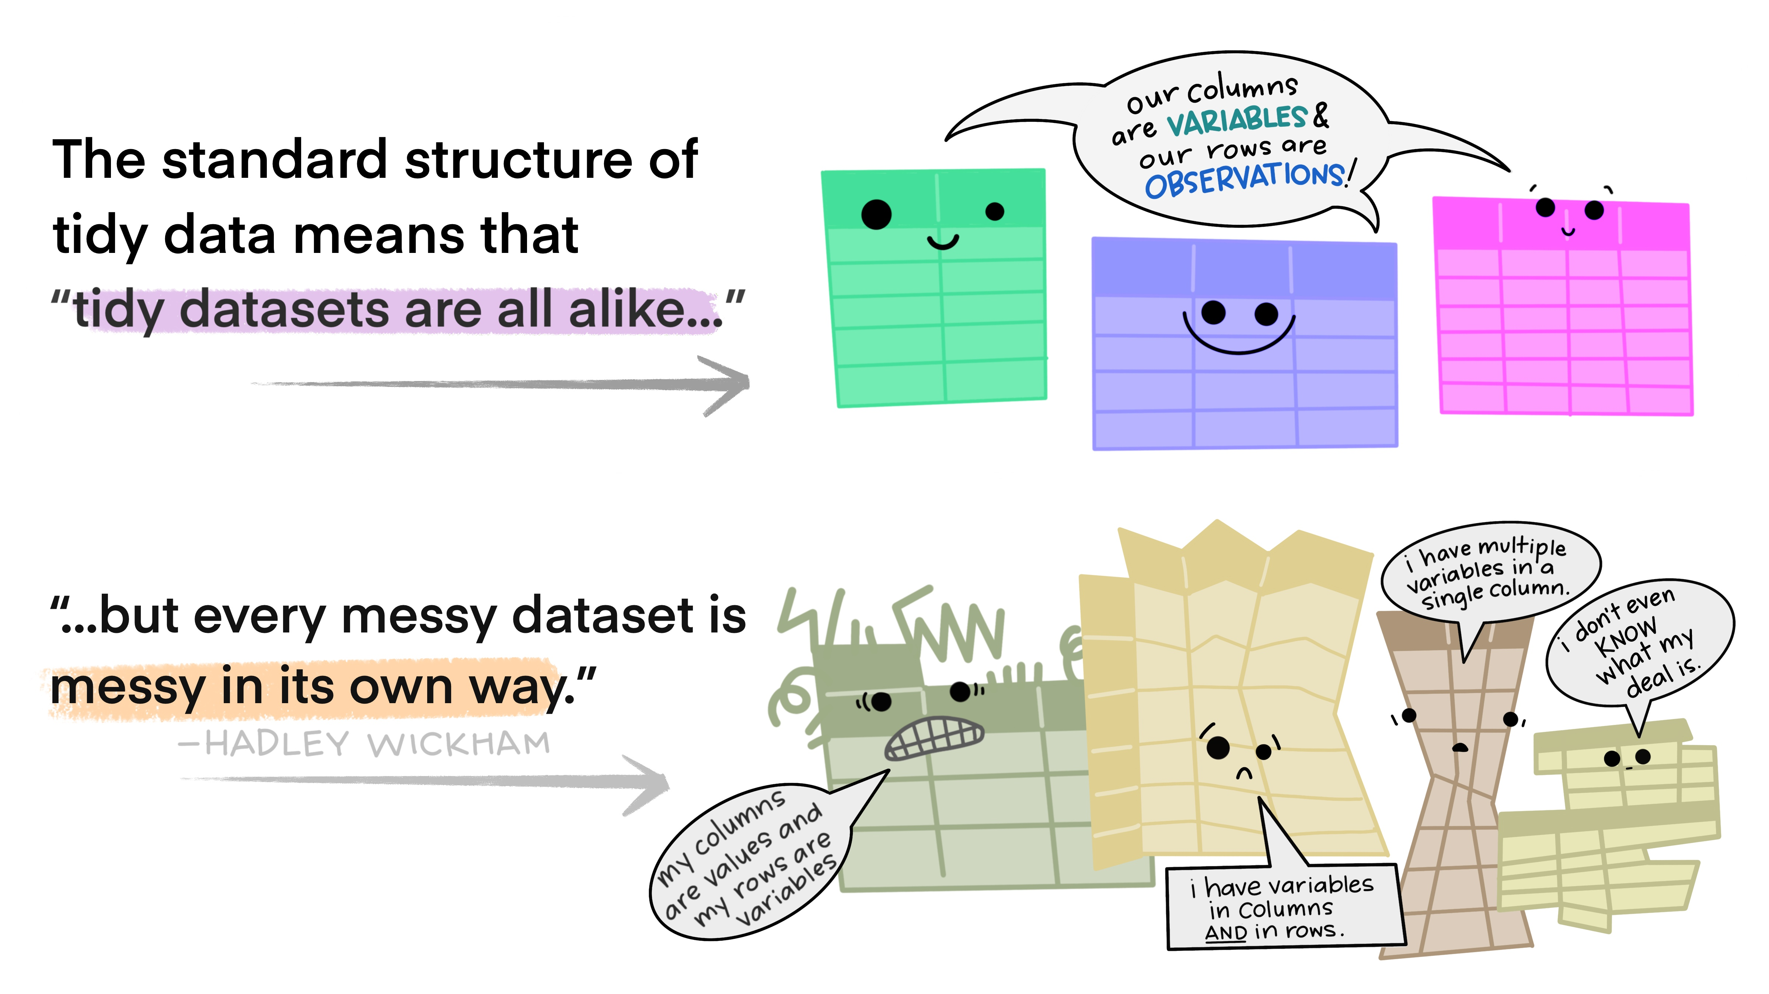
Tidy data

Slide 21
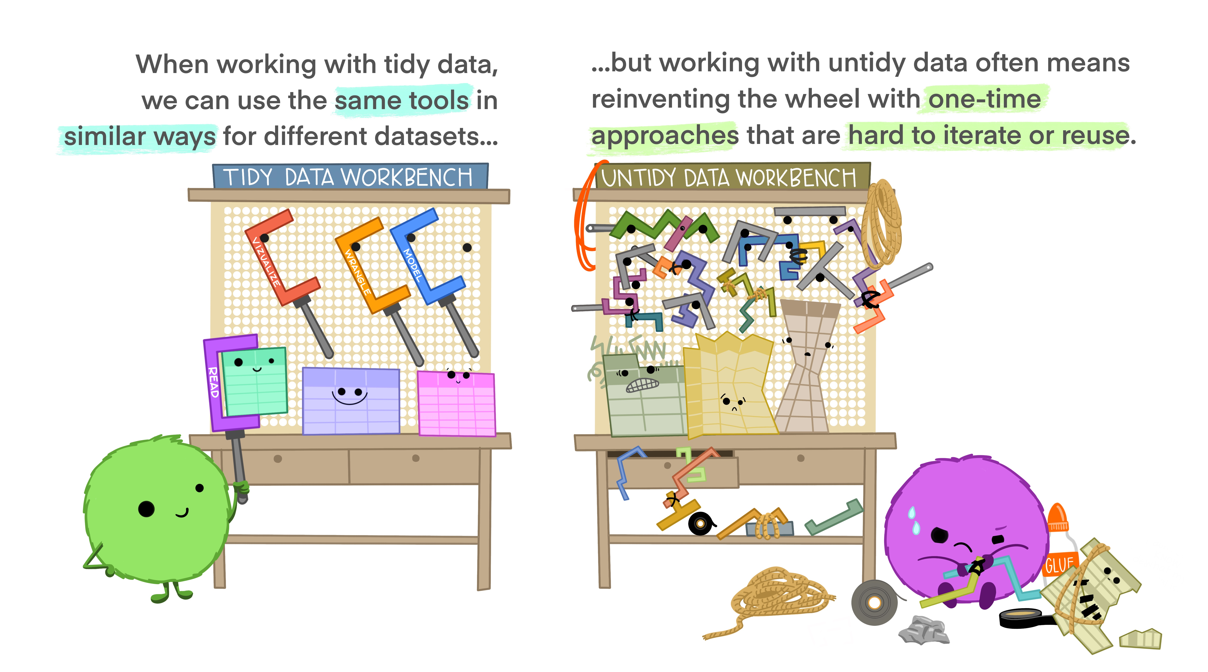
Tidy data

Slide 22

Tidy data

Slide 23
Reshaping data
Politics data is in the “long” format
Each row contains the values of variables associated with each country and year
Data is in the tidy format
country | year | V2x_libdem
Myanmar | 2012 | 0.137
Myanmar | 1997 | 0.018

Slide 24
Reshaping data
Carbon and gdp data is in a “wide” format.
This format means that each variable (i.e. emissions for 1751, emissions for 1752, and so on) is listed as its own column.
Data is not tidy
R functions expect your data to be in the “long” format because it is more machine readable.
country | 1751 | 1752 | 1753
Afghanistan | NA | NA | NA
Albania | NA | NA | NA

Slide 25
Note on column names
You might notice that in the carbon and gdp data, the column names are numeric. This practice is not recommended.
To refer to these columns, you will have to wrap them with backticks (`)
carbon$`2014`

Slide 26
Reshaping data
We want to convert carbon to a “long” format to make it more useful for visualization and analysis.
A “long” format means that we will have fewer columns than the current format (“wide”)
We want to collapse all emissions across the years into one new variable called “emissions.”
We identify what year the data point is from by creating a “year” variable

Slide 27
Reshaping data
country | 1751 | 1752 | 1753
Afghanistan | a | b | c
Albania | d | e | f
country | Year | emissions
Afghanistan | 1751 | a
Afghanistan | 1752 | b
Afghanistan | 1753 | c
Albania | 1751 | d
Albania | 1752 | e
Albania | 1753 | f

Slide 28
Reshaping data
We will use the pivot_longer() function.
4 arguments
The wide data
cols are the names of the columns we will use (or not use) to fill the new values variable
names_to refers to the column variable we wish to create the cols provided
values_to refers to the column variable we wish to create and fill with the values associated with the cols provided

Slide 29
Reshaping data
Looking at our carbon data,
4 arguments
wide data – carbon
cols - all columns except country, so –country
names_to – collapse all years to a new column called year
values_to – collapse all emissions values to a new column called emissions

Slide 30
Data Wrangling – reshaping data
carbon_long <- carbon %>%
pivot_longer(cols = -country,
names_to = “year”,
values_to = “emissions”)

Slide 31
Reshaping data
Always good to check if you did it correctly
carbon_long %>% slice_sample(n = 10)
Compare the dimensions of the carbon and carbon_long data frames.
How would you check for this?

Slide 32
Reshaping data
If you take a look at the structure of the data, you will notice that R encoded the year variable as character instead of numeric.
To create or modify columns, use the mutate() function.
carbon_long <- carbon_long %>%
mutate(year = as.numeric(year))
## carbon_long$year <- as.numeric(carbon_long$year)

Slide 33
Reshaping data
The gdp data is also in the same format. Let’s reshape it too. Notice the use of the %>%.
gdp_long <- gdp %>%
pivot_longer(cols = -country,
names_to = "year",
values_to = "gdp") %>%
mutate(year = as.numeric(year),
gdp = as.numeric(gdp))
head(gdp_long)

Slide 34
Reshaping data
In case you need to reshape the data into wide format, read the notes!

Slide 35
Selecting and Filtering
Let’s say you only want to keep certain variables from the politics data. You can use the select() function to perform this task.
You can add a minus sign in front of a variable to drop a variable
politics %>% select(country_name, year, v2x_libdem, v2x_regime, region)
politics %>% select(-v2psnatpar_ord)

Slide 36
Selecting and Filtering
The output of the codes we just ran will just print the data frame.
To save the new data frame, we have to use the assignment operator. We will just overwrite the original politics data.
politics <- politics %>% select(country_name, year, v2x_libdem, v2x_regime, region)

Slide 37
Selecting and Filtering
We can use the filter() function to filter observations.
Min(politics$year, na.rm = T)
Max(politics$year, na.rm = T)
politics <- politics %>% filter(year >= 1991 & year <= 2014)
politics %>% filter(region == "Africa")

Slide 38
Selecting and Filtering
You can also use the %>% to chain the commands
politics <- politics %>%
select(country_name, year, v2x_libdem, v2x_regime, region) %>%
filter(year >= 1991 & year <= 2014)

Slide 39
Renaming columns
To rename variables, the syntax is rename(new_name = old_name)
politics <- politics %>%
rename(country = country_name,
democracy = v2x_libdem,
regime = v2x_regime)
## also does the same thing names(politics)[which(names(politics) == "country")] = "country"

Slide 40
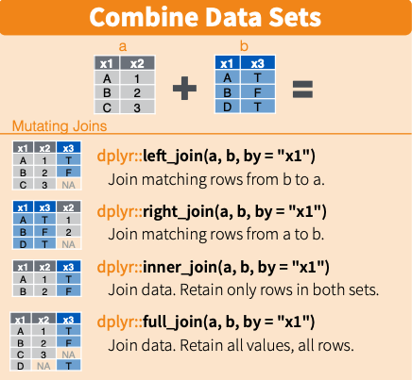
Joining data together

Slide 41
Joining data together
I want to keep all the observations in the carbon_long data, and join/merge with the gdp_long and politics data
data <- carbon_long %>%
left_join(gdp_long, by = c("country", "year")) %>%
left_join(politics, by = c("country", "year")) %>%
filter(!is.na(emissions) & !is.na(region) & !is.na(gdp)) %>%
filter(year >= 1991 & year <= 2014)

Slide 42
Another way to join
Use the merge() function
carbon_gdp <- merge(carbon_long, gdp_long, by = c("country", "year"), all.x = TRUE)
merged <- merge(carbon_gdp, politics, by = c("country", "year"), all.x = TRUE)

Slide 43
Creating new variables
Let’s say we want to create a new variable.
data <- data %>%
mutate(gdp_sq = gdp * gdp)
Or
data$gdp_sq <- data$gdp * data$gdp
Notes:
https://hhsievertsen.github.io/applied_econ_with_r/#5_Descriptive_Charts

Slide 44
Descriptive statistics
We can show some summary statistics using the following commands
mean(data$emissions, na.rm = T)
table(data$country)
summary(data)
summary(data$emissions)

Slide 45
Descriptive statistics
We can also compute summary statistics by region using group_by() and summarize() functions
data %>% group_by(region) %>%
summarize(n = n(),
avg_emissions = mean(emissions, na.rm = T),
median_gdp = median(gdp, na.rm = T))

Slide 46
Descriptive statistics
You can also use the arrange() function to sort values.
data %>% group_by(region) %>%
summarize(n = n(),
avg_emissions = mean(emissions, na.rm = T),
median_gdp = median(gdp, na.rm = T)) %>%
arrange(desc(median_gdp), desc(avg_emissions))

Slide 47
Descriptive statistics
We can use the {modelsummary} package to generate nice looking tables. Read here for more ways to customize your table.
datasummary_skim(politics)
datasummary_skim(data, type = "categorical")
# To export
datasummary_skim(data, output = here("output", "categorical_summary_statistics.html"))

Slide 48
Data Visualization
There are {base} R functions to plot data, such as plot() and hist()
We will focus on ggplot2. Read this tutorial/book for an in-depth intro.
ggplot2 is based on the “Grammar of Graphics that allows you to compose graphs by combining independent components...The grammar tells us that a graphic maps the data to the aesthetic attributes (color, shape, size) of geometric objects (points, lines, bars)”

Slide 49
Data Visualization
There are 3 main components in every ggplot2 plot.
The data
A set of aesthetic mapping
At least one layer that describes how to render each observation
Common layers
geom_line() for trend lines, time series, etc
geom_point() for scatter plots
geom_boxplot() for boxplots
geom_bar() and geom_col() for bar charts
geom_histogram() for histograms

Slide 50
Scatterplots
Let’s try to visualize the relationship between the gdp and emissions variables in our data data frame (Sorry, should have named the data frame differently!)
The data = data
Aesthetics = gdp mapped to the x axis, emissions to the y axis
Layer = points or geom_point()

Slide 51
Scatterplots
options(scipen=99999) # turn off scientific notation
ggplot(data, aes(x = gdp, y = emissions)) +
geom_point()

Slide 52
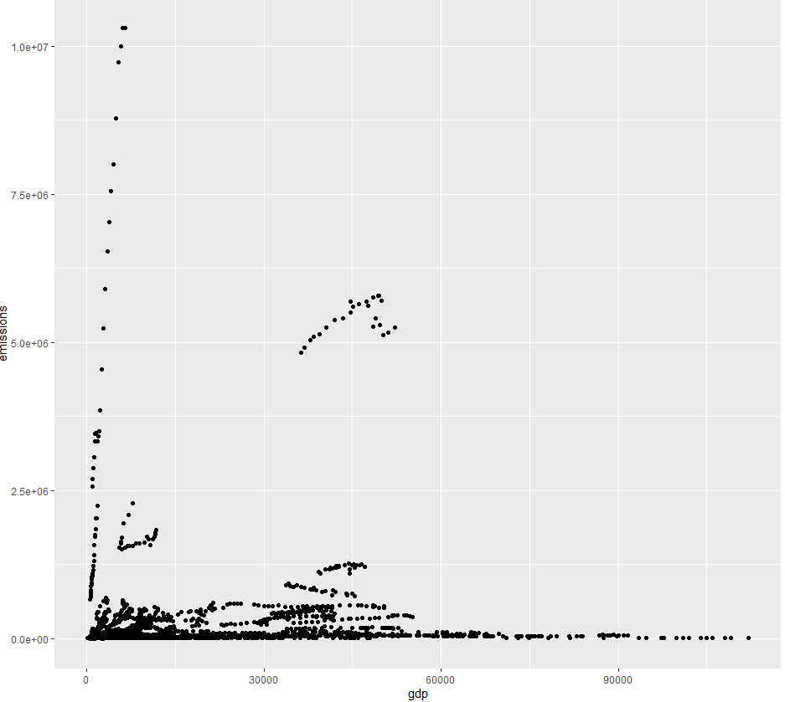

Scatterplots

Slide 53
Scatterplots
ggplot(data, aes(x = log(gdp), y = log(emissions))) +
geom_point()
The data and aesthetic are inside the ggplot() function. The layer is added with a +.
Since most maps plots a variable to x and y, first two arguments in aes() will be mapped to x and y.
ggplot(data, aes(log(gdp), log(emissions))) +
geom_point()

Slide 54
Scatterplots
We can also plot another variable to our plot by using other aesthetics such as color, shape, and size.
This code changes the color of the point based on the country’s region.

Slide 55
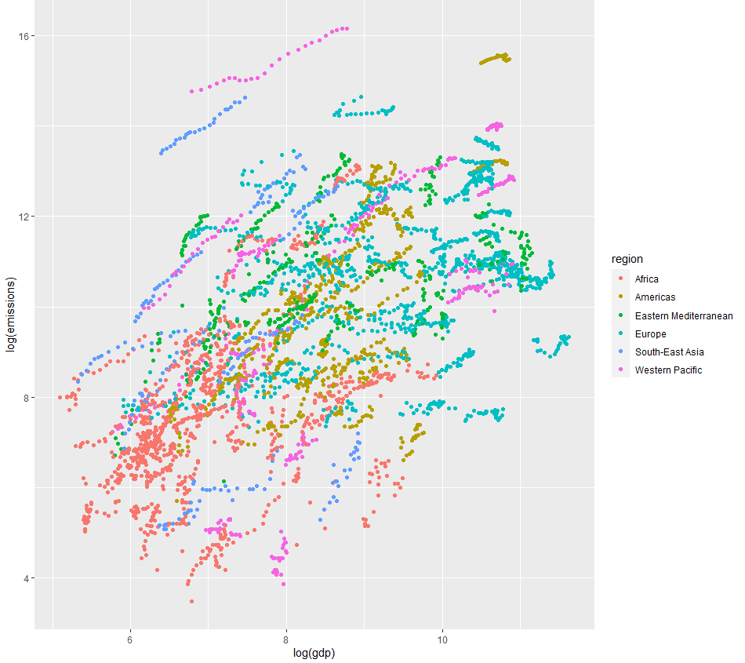
Scatterplots
ggplot(data, aes(log(gdp), log(emissions), color = region)) +
geom_point()

Slide 56
Scatterplots
We can also use the pipe operator with ggplot2. This method is useful if you want to make changes to the data (e.g. filter or mutate) before plotting.
Let’s calculate the average emissions and average GDP per country. Then plot it.
This will be my “base” graph so I will assign the plot to object p. I can add more layers to p later on.

Slide 57
Scatterplots
p <- data %>%
group_by(country) %>%
mutate(avg_emissions = mean(emissions, na.rm = T),
avg_gdp = mean(gdp, na.rm = T)) %>%
ggplot(aes(log(avg_gdp), log(avg_emissions))) +
geom_point()
p

Slide 58
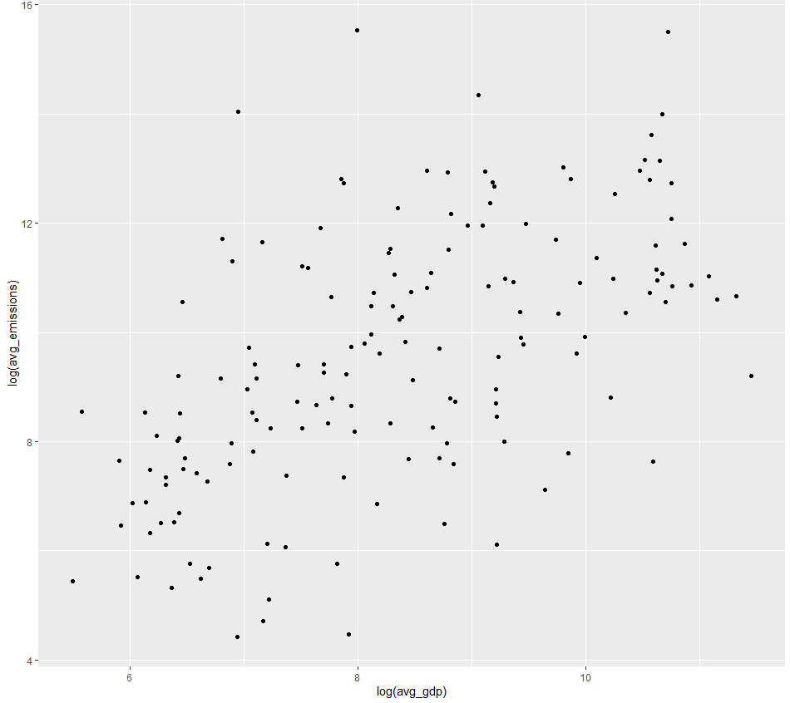
Scatterplots

Slide 59
Adding layers
We build our plots iteratively. Now let’s add a title and label the axes. Since we already saved the base plot to object p, we can just add layers to using +.
p <- p + labs(title = "Relationship between Emissions and GDP",
y = "Log GDP per capita", x = "Log CO2 per capita")
p

Slide 60
Adding a trend line
We can add a fitted line using geom_smooth(). If we want a fitted line based on a linear model, we have to specify it using geom_smooth(method = “lm”)

Slide 61
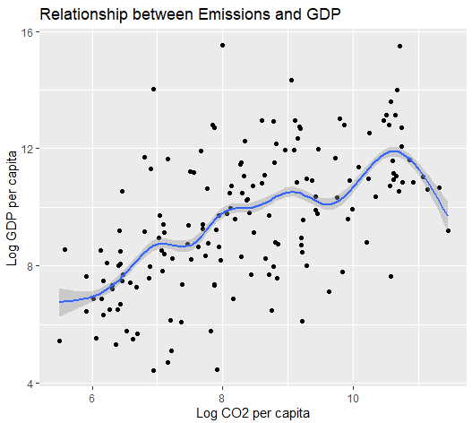
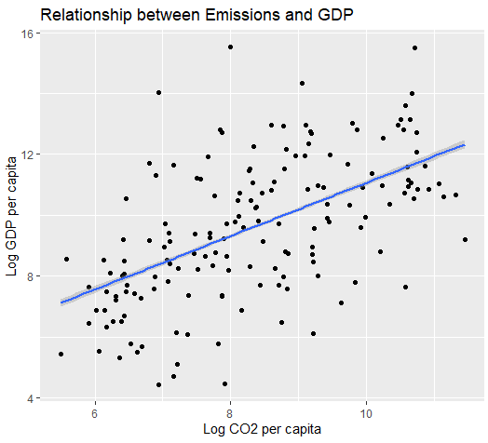
Adding a trend line
p + geom_smooth()
p + geom_smooth(method = “lm”)

Slide 62
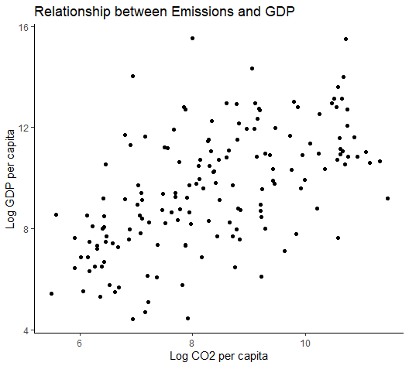
Changing the theme
There are different themes available. Let’s say we want to use the theme_classic()
“A classic-looking theme, with x and y axis and no grid lines”
p <- p + theme_classic()
p

Slide 63
Saving the plot
The recommended practice is to use the ggsave() function.
Use the Export button in the ‘Plots’ tab, but this action is not good for reproducibility.
Please don’t just take the a screenshot of the image!
Can save as png, jpg, pdf, etc.
ggsave(p, filename = here("output","emissions_gdp.png"))

Slide 64
Boxplots
bp <- data %>%
filter(year == 2010) %>%
ggplot(aes(region, gdp)) +
geom_boxplot() +
labs(title = "Distribution of GDP by Region, 2010",
y = "GDP per capita", x = "Region") +
theme_classic()
bp

Slide 65
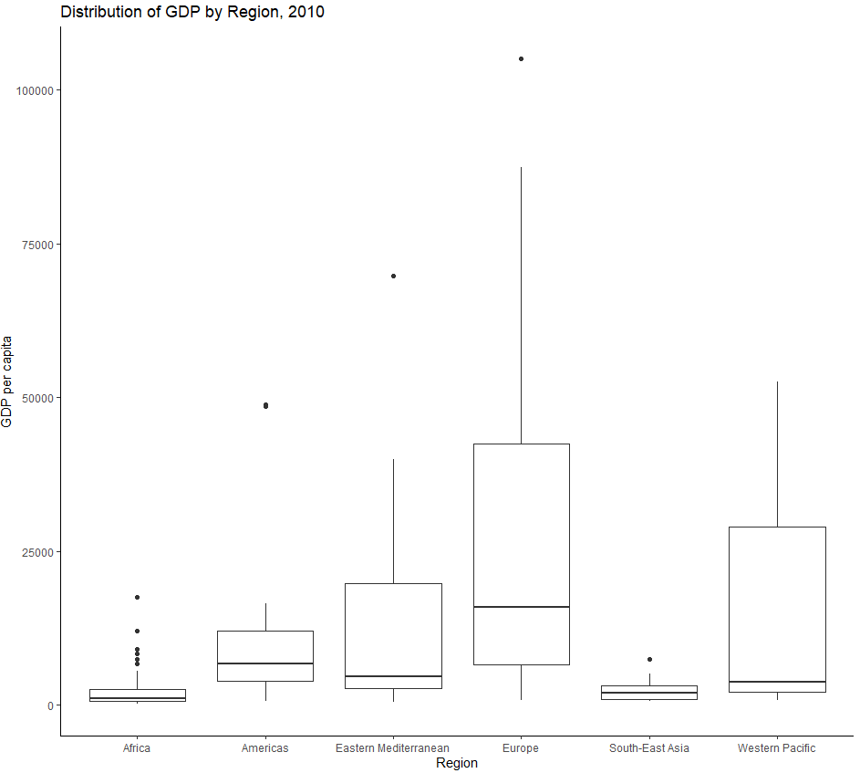
Boxplots

Slide 66
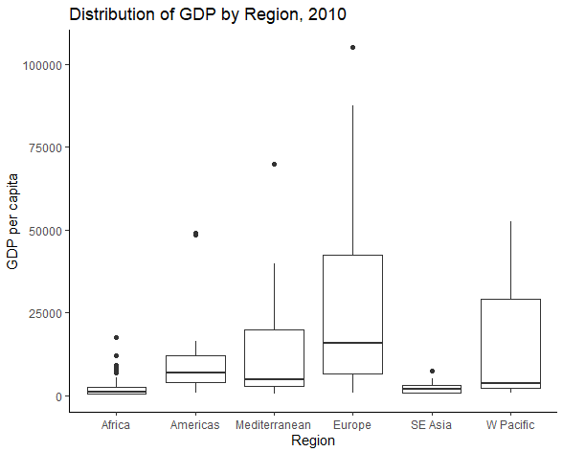
Edit the tick marks
bp + scale_x_discrete(labels = c("Africa", "Americas", "Mediterranean", "Europe", "SE Asia", "W Pacific"))

Slide 67
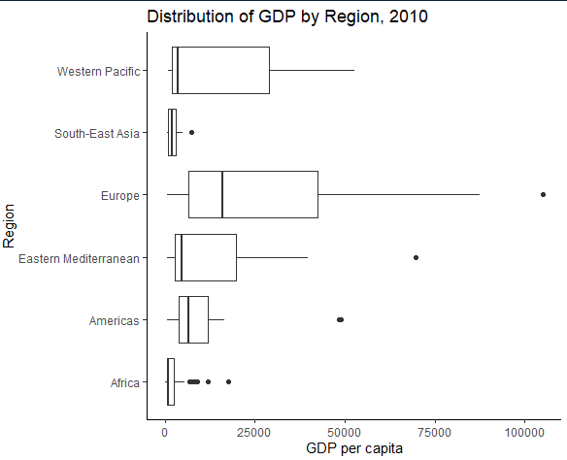
Flipping the coordinates
bp + coord_flip()

Slide 68
Line plots
Let’s plots Canada’s emissions over time
lp <- data %>%
filter(country == "Canada") %>%
ggplot(aes(x = year, y = emissions)) +
geom_line(linetype = "dashed", color = "red") +
theme_classic() +
labs(title = "Canada's CO2 emissions, 1991-2014",
y = "Total Emissions",
x = "Year")
lp

Slide 69
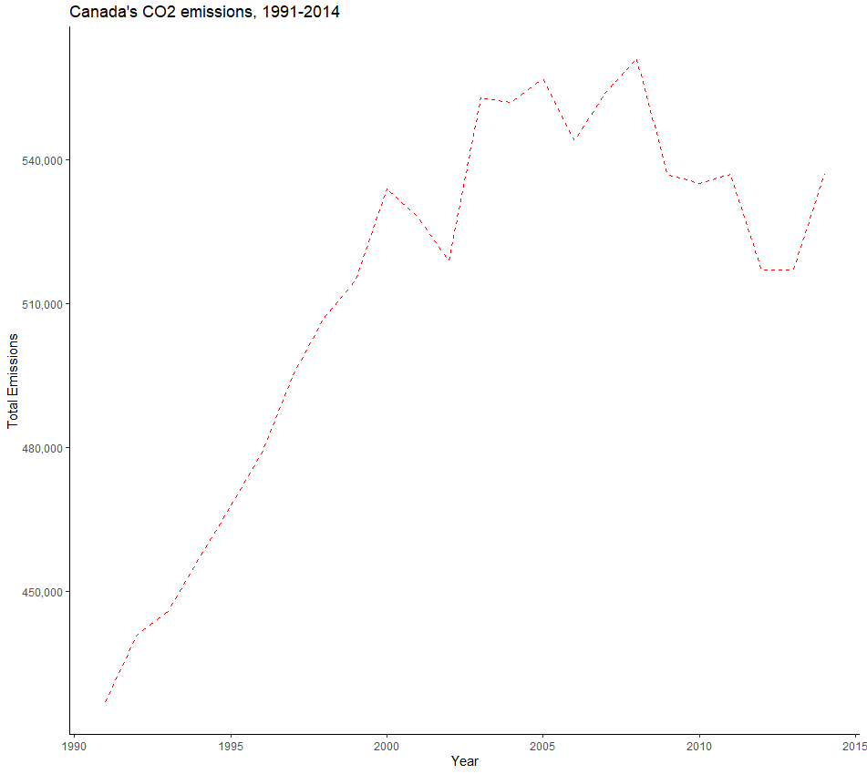
Adding a comma to the scale
lp + scale_y_continuous(labels = scales::comma)

Slide 70
Histogram
ggplot(data, aes(x = gdp)) +
geom_histogram() +
theme_classic() +
labs(title = "Income Distribution, 1991-2014",
y = "Count",
x = "GDP per capita")

Slide 71
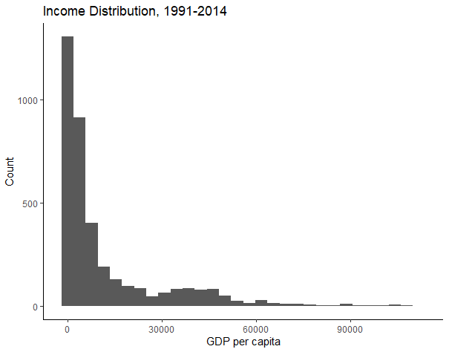
Histogram

Slide 72
Analysis
Pairwise t-test
Correlation
Regression

Slide 73
Comparing CAN & AUS
Let’s compare the carbon emissions of Canada and Australia.
data %>%
filter(country == "Canada" | country == "Australia") %>%
group_by(country) %>%
ggplot(aes(x = country, y = emissions)) +
geom_boxplot() +
labs(title = "Comparing Canada and Australia's emissions, 1991-2014",
y = "Emissions",
x = "Country")

Slide 74
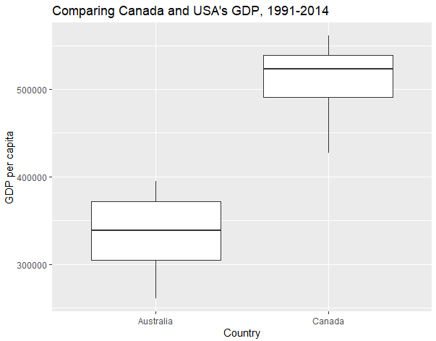
Comparing CAN & AUS

Slide 75
t-test
can_aus <- data %>%
filter(country == "Canada" | country == "Australia")
options(scipen = 0) # to allow for scientific notation again
can_aus_ttest <- t.test(emissions ~ country, data = can_aus)
can_aus_ttest

Slide 76
Correlation
How related are country’s average emissions and average GDP?
data <- data %>%
group_by(country) %>%
mutate(avg_emissions = mean(emissions, na.rm = T),
avg_gdp = mean(gdp, na.rm = T))

Slide 77
Correlation
cor <- cor.test(data$avg_emissions, data$avg_gdp, method = "pearson")
cor
str(cor)
cor$estimate

Slide 78
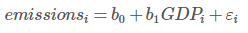
Regression
reg1 <- lm(emissions ~ gdp, data = data)
reg1
summary(reg1)
str(summary(reg1))
summary(reg1)$coefficients

Slide 79
Exporting results
tidy_reg1 <- tidy(reg1)
write_csv(tidy_reg1, file = here("output", "tidy_reg1.csv"))
modelsummary(reg1,
coef_rename = c("gdp" = "GDP", "(Intercept)" = "Intercept"),
stars = TRUE, statistic = 'std.error',
fmt= '%.4f',
gof_omit = 'DF|AIC|BIC|Log|R2 Adj.',
output = 'flextable')

Slide 80
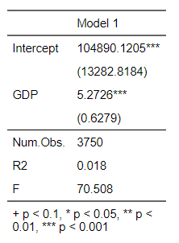
Exporting results

Slide 81
What we just did
Conduct pairwise t-test
Calculate the correlation coefficient
Run an OLS regression in R

